Slide 1
^{Holding in the Bottom} ^{While Sustaining the Top:} A Balanced Approach for L2 Reading Instruction
Neil J Anderson
Brigham Young University
Provo, Utah

Slide 2
Holding in the Bottom While Sustaining the Top: A Balanced Approach for L2 Reading Instruction

Slide 3
INTERACTIVE READING INSTRUCTION
Eskey (1988) pointed out 25 years ago that second language reading instruction “exhibit[ed] a strongly top-down bias” (p. 95) and thus as second language reading specialists, we needed to do a better job of helping L2 readers “hold in the bottom” by including systematic decoding instruction as part of a second language reading curriculum as well as instruction on how to effectively use top-down strategies.

Slide 4
Top-down reading instruction
Reading begins with reader background knowledge of
people, places, events, and activities
Comprehension

Slide 5
Bottom-up reading instruction
Comprehension
Knowledge of individual sounds, letters, and words

Slide 6
Interactive reading instruction
Reader background knowledge
Comprehension
Knowledge of individual sounds, letters, and words

Slide 8
Birch (2007) Hypothetical Model of the Reading Process (p. 3)
Processing Strategies | Knowledge Base
Cognitive Processing Strategies
Inferencing
Predicting
Problem-solving
Constructing meaning
World Knowledge
People
Places
Events
Activities
TEXT
Language Processing Strategies
Chunking into phrases
Accessing word meaning
Word identification
Letter recognition
Language Knowledge
Sentences
Phrases
Words
Letters
Sounds

Slide 9
In this model of the reading process, the processing strategies work together in parallel, that is, at the same time, with access to the knowledge base to permit the reader to construct ideas and meaning from the printed text. When someone is reading, they need both the information flowing upward from the bottom to the top and the information flowing downward from the top to the bottom in order to understand the meaning successfully. (Birch, 2007, p. 4)

Slide 10
Birch (2007) Hypothetical Model of the Bottom of the Reading Processor (p. 6)
Cognitive Processing Strategies | World Knowledge Base
Language Processing Strategies | Knowledge Base for Language
Syntactic Processing Strategies
Phrases and
sentences
Lexical Processing Strategies
Words and
word meaning
TEXT
Orthographic Processing Strategies
Letters
Phonological Processing Strategies
Sounds

Slide 11
In practical terms, my concern is thus to keep the language in the teaching of second language reading. That may not sound very controversial, but I think that in promoting higher-level strategies—like predicting from context or the use of schemata and other kinds of background knowledge—some researchers have been sending a message to teachers that the teaching of reading to second langauge readers is mostly just a matter of providing them with the right background knowledge for any texts they must read, and encouraging them to make full use of that knowledge in decoding those texts. Though that is certainly important, it is also, I think, potentially misleading as a total approach. . . . We must not, I believe, lose sight of the fact that language is a major problem in second language reading, and that even educated guessing at meaning is not a substitute for accurate decoding. (Eskey, 1988, p. 97)

Slide 12
Intensive Reading Instruction
Extensive Reading Instruction
Phonological
Instruction
Narrative
Texts
Vocabulary
Instruction
Strategic
Reading
Expository
Texts
The Goal:
Comprehension
Reading
Fluency
A model for a balanced reading curriculum (Anderson, 2014, p. 179)

Slide 14
I always win! (Waring, R., & Jamall, M. [2006]. Boston, MA: Thomson ELT)
Narrative text

Slide 15
I always win! (Waring, R., & Jamall, M. [2006]. Boston, MA: Thomson ELT)

Slide 16
win
*
x

Slide 17
cup
*
x

Slide 18
fast
*
*
x

Slide 19
line
x
x

Slide 20
race
s
x
x

Slide 21
remember
x
x
x

Slide 22
Rapid Word Recognition
friend | friends find friendly fine friend
ready | really read readily ready reads
remember | remembered remember remembers remembering
win | won when whine win wins
cup | cup cap cop cups caps
finish | finishes finishing fish finished finish
gate | game gate gates gain gator
fast |feast fist faster fast fastest
race | race races raze raced razed
line | land lines lime lane line

Slide 23
Comprehension Check
How well do you know the words 1-10 from this rapid word recognition activity? To the left of the number on the worksheet, write one of the four numbers to indicate how well you know each word.
0 = I do not know this word.
1 = I think I have seen this word before, but I do not know what it means.
2 = I have seen this word before and I think I know the definition, but I’m not sure.
3 = I know the definition of this word.

Slide 25
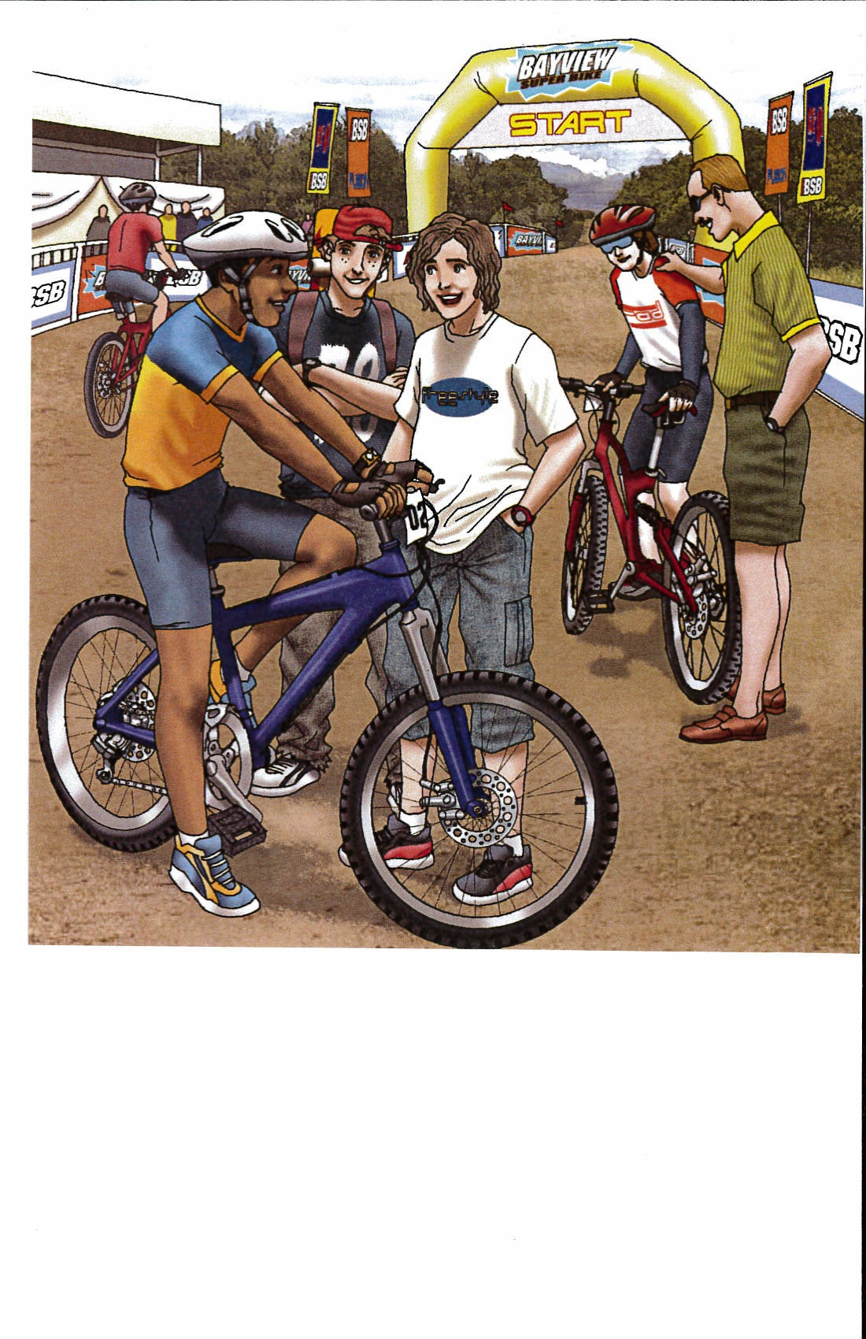
Activation of Background Knowledge
What sports do you like?
What do you know
about bike racing?

Slide 27
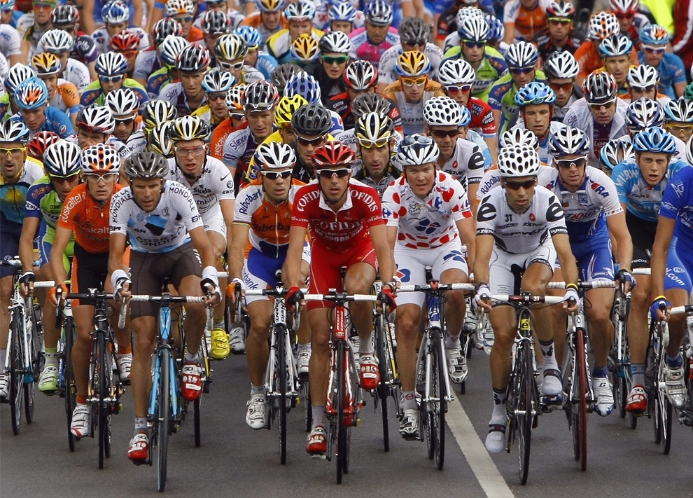
Activation of Background Knowledge
Do you remember when we read, I Always Win!
What happened in that story?
What famous bike race
do you know?

Slide 28
Tour de France. (2013). (Reading Horizons, Reading Library, Book 1. North Salt Lake, UT: Reading Horizons)
Expository text

Slide 29
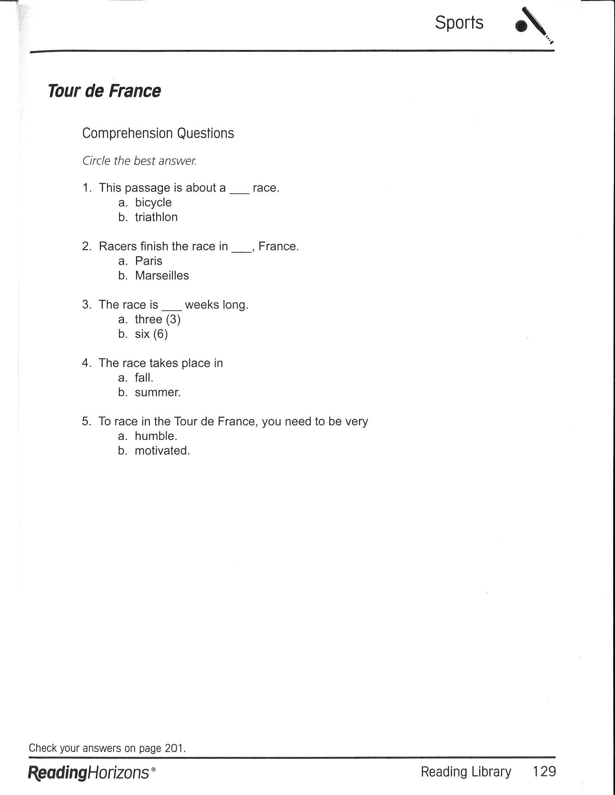
Tour de France. (2013). (Reading Horizons, Reading Library, Book 1. North Salt Lake, UT: Reading Horizons)

